Slide 1
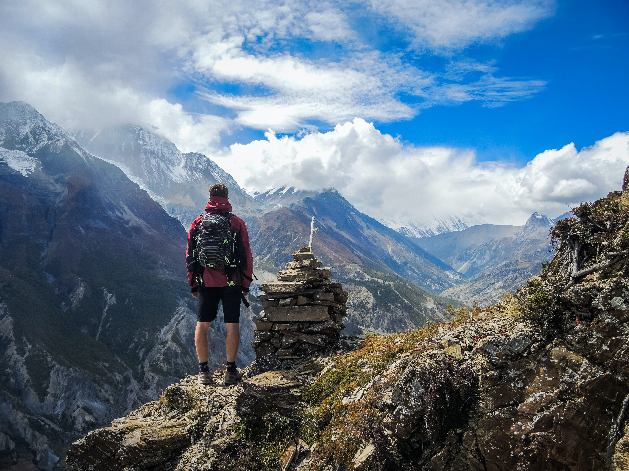
“The world reveals itself to those who travel on foot.”
Trek’s Mate
Team Members:
Muna Sunar
Nischal Malla
Suraksha Adhikari

Slide 2

Contents
Introduction
Problem Statement
Objective
Motivation
Literature Review
Methodology
Diagrams
Abstract
References

Slide 3
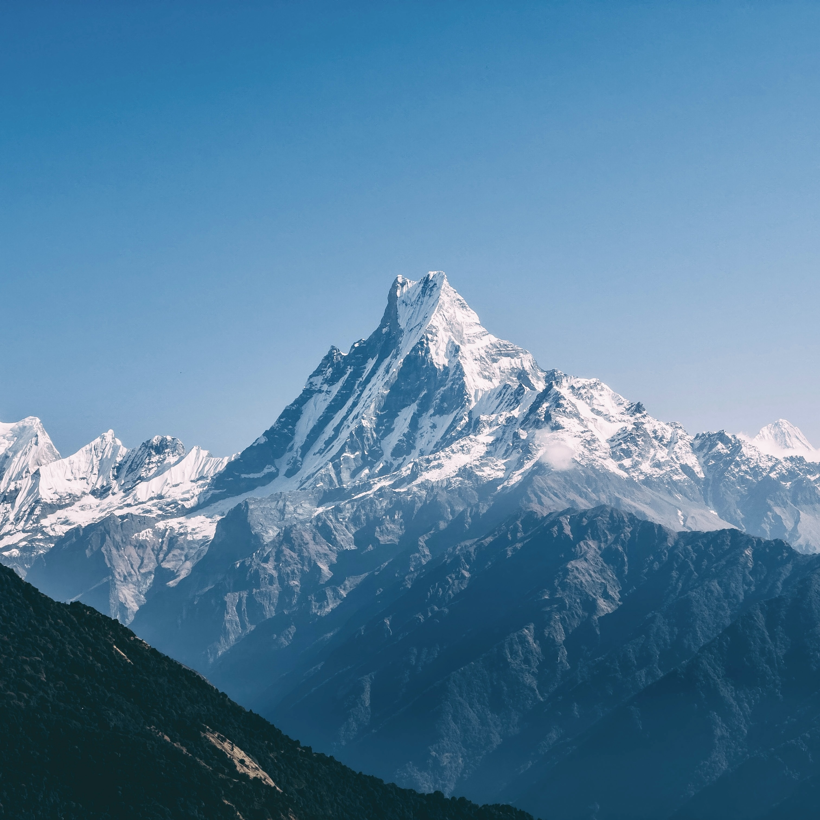
Introduction
Nepal is an ideal destination for hiking, attracting thousands of hikers every year,
According to the data collected from Nepal Tourism Board (NTB) approximately 500,000 foreigner visitors visited Nepal in last 10 months.[1]
Every year the tourism industry contributes about 6.7 percent to Nepal’s GDP, while its total impact was US $2.2 billion.[2]
Trekker wants to experience the most out of their journey with little to no difficulty,
In this modern era, a tool is needed for the ease of trekking and travelling.
Thus, introducing our app ‘Trek’s Mate’.

Slide 4
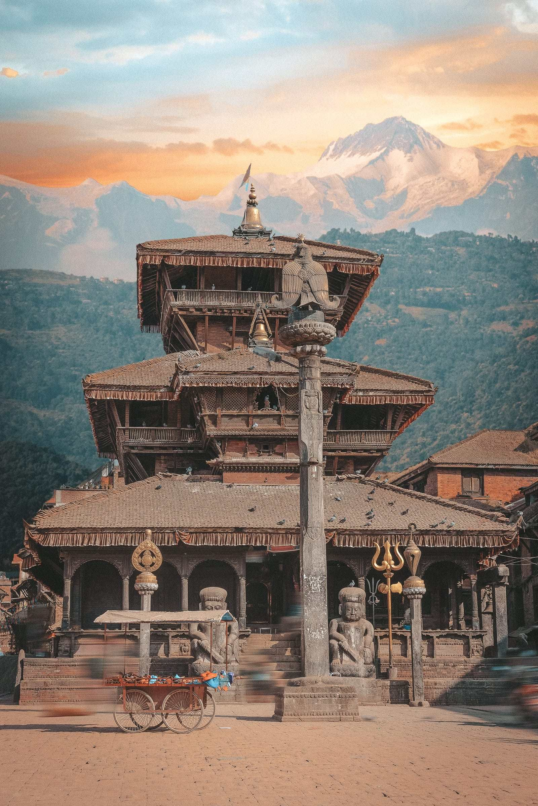
Problem Statement
One of the main reason the tourism sector has not grown to its full potential despite the resource Nepal possess is due to the lack of visibility of its tourist destinations.
Therefore, the problem of tourism sites obscurity must be addressed in order to keep the flow of tourist and generate more revenue form the industry.

Slide 5
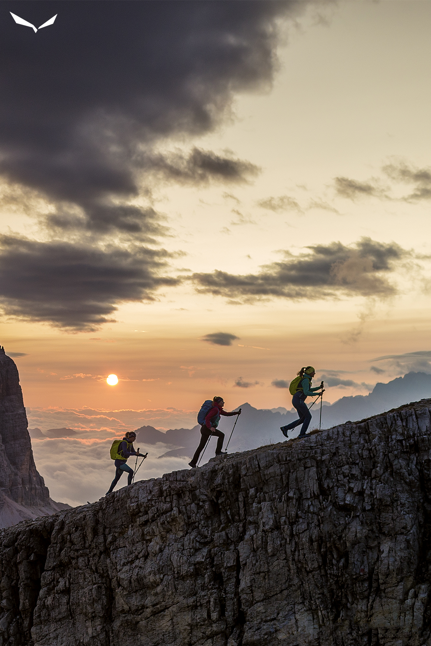
Objective
To develop a web application that provides trekkers with reliable and comprehensive information about the trek,
To enhance hiking experience and satisfaction by making the app user-friendly and up-to-date,

Slide 6
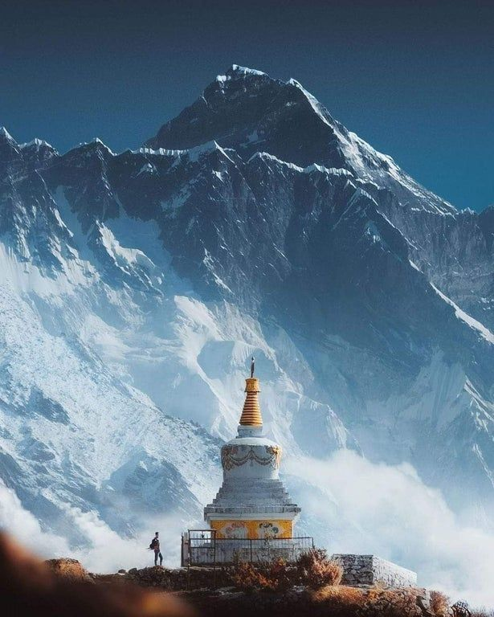
Motivation
In this modern world, trekker are still using their guidebooks which are far too outdated but they are bound to use them as only source of information,
Sometimes following the route provided by the guidebooks will be time consuming and resource wasting as they may meet with unexpected weather changes, roadblock or even safety hazards,
This modern technological age demands a tool to make trekker’s and travelers instant experts regarding the route, weather report and budget.
Thus, Trek’s Mate is developed to overcome all the difficulties faced by traditional tourism industry.

Slide 7
Literature Review
Very few projects have been made on trek management system:
Destination Information Management System for Tourists
Social media Based Recommendation System
The Application of Intelligent Tourism Mobile Client Based on Ontology

Slide 8
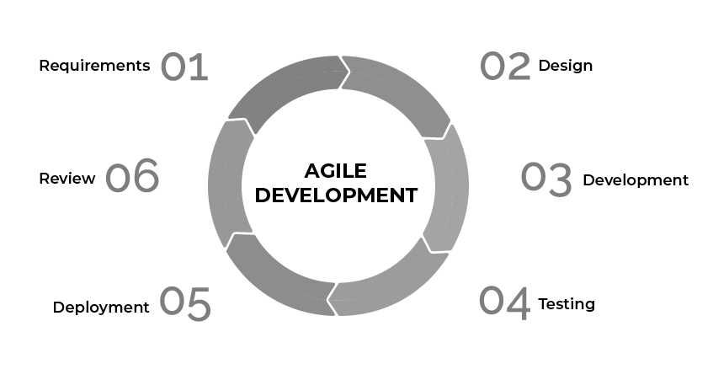
Methodology
We are employing agile approach as the software development methodology.
A software development methodology based on iterative development is referred to as an "agile process model.”
Agile project management techniques divide work into smaller iterations or pieces without directly including long-term planning.

Slide 9
Scrum Model
Scrum is the type of Agile framework. It is a framework within which people can address complex adaptive problem while productivity and creativity of delivering product is at highest possible values. Scrum uses Iterative process

Slide 10





For this project, we propose to use the following web development tools and frameworks:
React () )): A JavaScript library for building user interfaces that are fast, responsive, and dynamic. React is widely used and supported by a large community of developers
Bootstrap( ): Bootstrap provides a collection of ready-made components, such as buttons, forms, navigation bars, and grids, that can help us create a consistent and attractive user interface for the web app.
Mongoose Database( ): Mongoose is an Object Data Modelling (ODM) library for MongoDB and Node.js. It manages relationships between data, provides schema validation, and is used to translate between objects in code and the representation of those objects in MongoDB.
Express( ):Express, is a back end web application framework for building restful APIs with Node.js, released as free and open-source software.
Node JS ( ) :Node JS is a back-end JavaScript engine and executes JavaScript code outside the web browser.

Slide 11
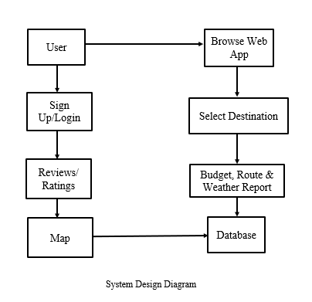
System Design Diagram

Slide 12
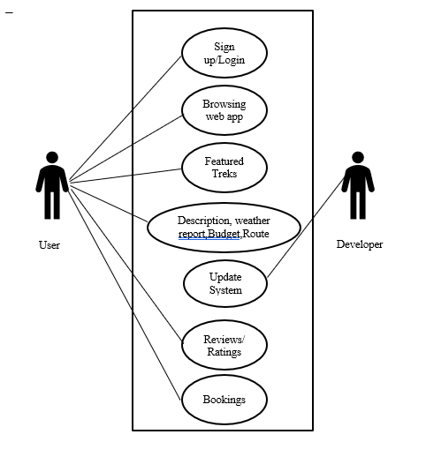
Use Case Diagram

Slide 13
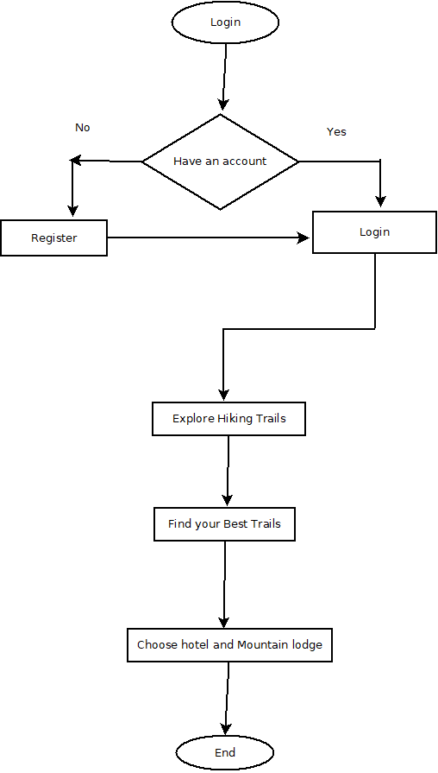
Flowchart

Slide 14
Work Division

Slide 15
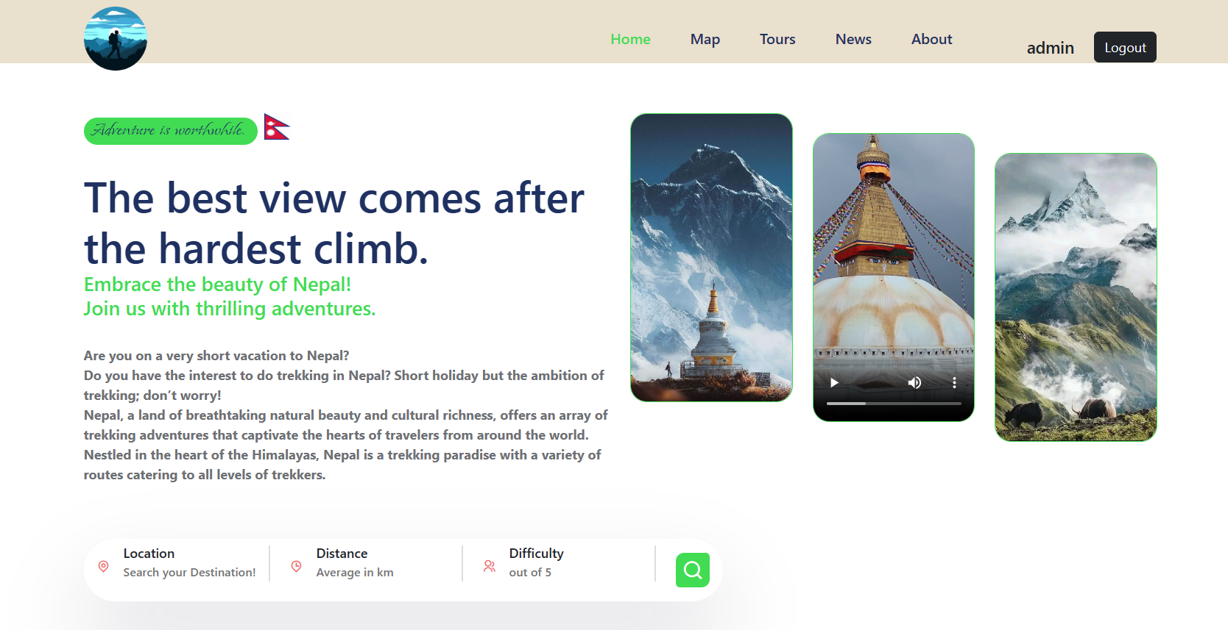
Expected Outcome

Slide 16
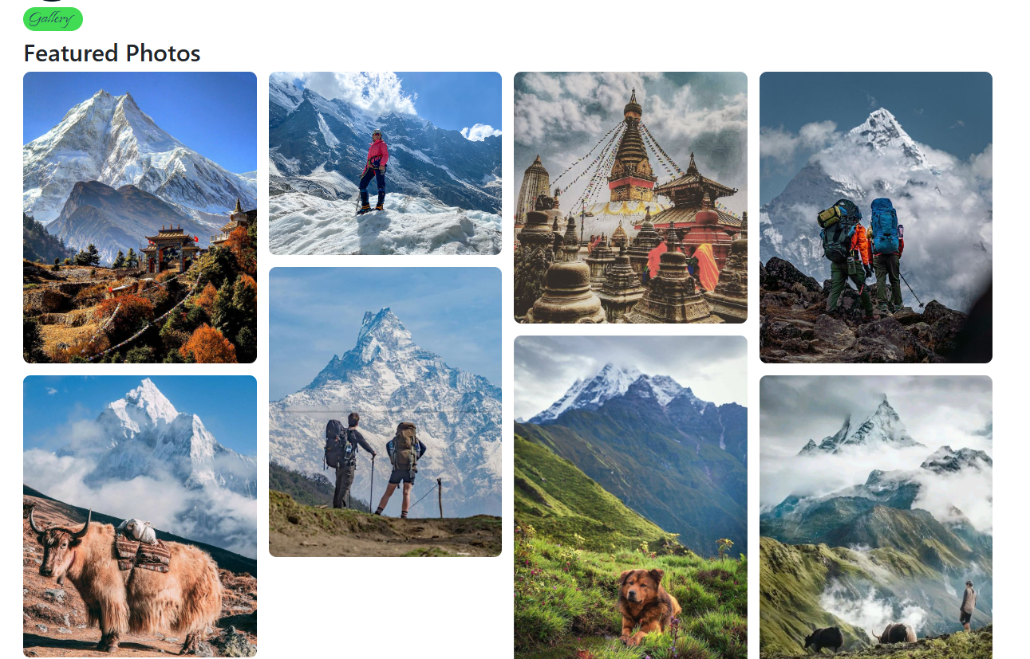

Slide 17
Abstract
Our project ‘Trek’s Mate’ is a web-based application which will recommend the location considering the preference of the tourists,
This app offers the features such as General information about the trek (best time, equipment, weather forecast etc.),

Slide 18
References
[1]Over 500,000 tourists visit Nepal in 10 months (2022) https://myrepublica.nagariknetwork.com/news/over-500-000-tourists- visit-nepal-in-10-months/. República Nepal.
[2] https://www.worldbank.org/en/news/feature/2022/06/03/harnessing-tourism-to-enhance-the-value-of-biodiversity-and-promote-conservation-in-nepal

Slide 19

Thank You! 🙏

